Slide 1
Presidents on the fast track: Fighting floor amendments in the Chilean Cámara
Eric Magar Valeria Palanza Gisela Sin
ITAM, Mexico Univ. Catolica, Chile University of Illinois
Rome Workshop

Slide 2
What is fast-track authority authority?
Allows the executive to set the agenda by interfering with legislative scheduling at will (Carey&Shugart 1998, Morgenstern 2002)

Slide 3
What is fast-track authority authority?
Allows the executive to set the agenda by interfering with legislative scheduling at will (Carey&Shugart 1998, Morgenstern 2002)
When a bill declared urgent:
Bill Always Needs Legislature Support
Colombia and Chile: No reversion point if Congress does not comply. Any topic
Brazil: it goes to the top of the schedule and all voting activity in the floor stops (45 days)
USA: International Trade Agreements

Slide 4
What is fast-track authority authority?
Allows the executive to set the agenda by interfering with legislative scheduling at will (Carey&Shugart 1998, Morgenstern 2002)
When a bill declared urgent:
Always Needs Legislature Support
Colombia and Chile: No reversion point if Congress does not comply. Any topic
Brazil: it goes to the top of the schedule and all voting activity in the floor stops (45 days)
USA: International Trade Agreements
If Legislature does not act within certain number of days, bill becomes law
Uruguay: 3/5 of member can remove “urgency” label, no more than 1 urgent bill at a time
Ecuador: economic issues, limit in number of urgent bills at one time
Paraguay: any subject
USA: Howell & Moe (2017) argue for constitutional reform to grant U.S. presidents universal fast track authority

Slide 5
Fast-Track authority in Chilean constitution and law
Any bill at any stage can be declared urgent.
Chamber must “discuss and vote” before 30 days
Law sets the breadth of the interference
‘act now’ (discusion inmediata, 6 days)
‘two weeks’ notice (urgencia suma, 15 days)
‘four weeks’ notice (urgencia simple, 30 days)
Can remove the urgency, with immediate effects
No consequences for non-compliance

Slide 6
Cheap talk?
Speed of consideration (1990–94):
urgent 29.0 weeks
rest 29.7 (Siavelis 2002)
Yet 60 % exec. proposals urgent!
And strongly associated with likelihood of passage
→ Berrıos & Gamboa (2006), Aleman & Navia (2009): It’s a signaling tool

Slide 7
Our Argument
Does NOT expedite legislative process
NOT a signal
Urgency = cooperation-enhancing mechanism between president and coalition
Urgent bills are much harder to modify in the floor → closed rule protects vote-trading deals made in committee

Slide 8
Legislative Process in Chile
1st Committee Report
Floor Debate in General
2nd Committee Report
Floor Debate, article by article
Floor amendments introduced for each article

Slide 9
Legislative Process in Chile with Urgency Authority
1st Committee Report
Floor Debate in General
2nd Committee Report
Floor Debate, article by article
Floor amendments introduced for each article

Slide 10
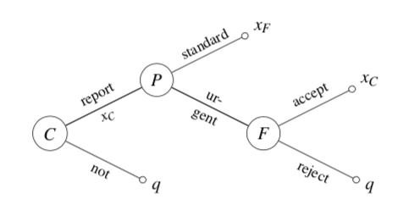
A game (extends Dion&Huber1996)
Key result (spatial model):
standard consideration only when president and committee on either side of the floor median
Hypothesis
Pr(bill urgent) greater when president and committee chair are co-partisans

Slide 11
Data
Original dataset of bill histories 1998–2014
Notes:
who introduced the bill, when, in which chamber, the issue it deals with, its status at the time of consultation, and so forth. We also gathered information on the chronological detail of the bill’s legislative process in the House: committee refer- rals and reports, floor discussion and voting, navette to the Senate, and more. Of direct relevance, we coded all urgency messages received by the Cámara. Table 2 offers a general summary of bill introduction, passage, and urgency incidence.

Slide 12
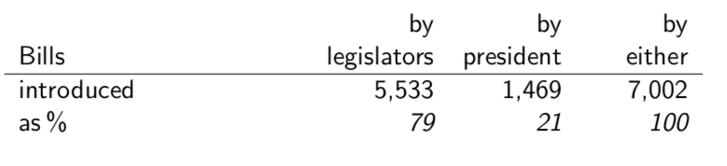
Data
Original dataset of bill histories 1998–2014

Slide 13
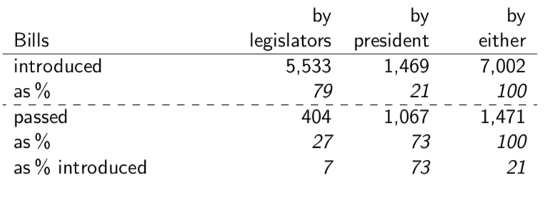
Data
Original dataset of bill histories 1998–2014
Notes:
The executive ninety-one yearly on average. Executive bills represented about one in five proposals in the
the executive’s success rate at 72 percent—high by Latin American standards (Morgenstern and Nacif 2002).

Slide 14
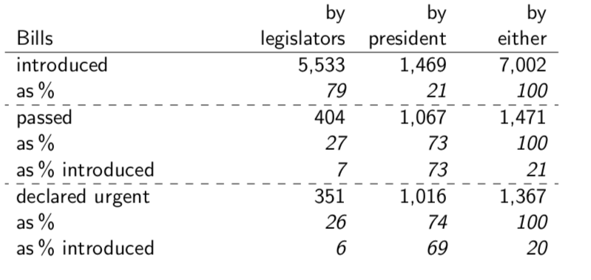
Data
Original dataset of bill histories 1998–2014
Notes:
And 834 bills became urgent during lower chamber consideration, more than half of all (57 percent).

Slide 15
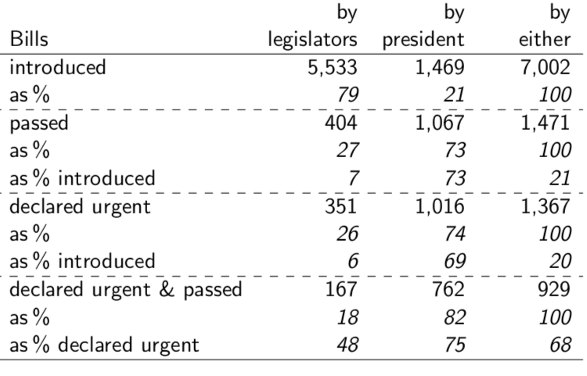
Data
Original dataset of bill histories 1998–2014
Notes:
And 834 bills became urgent during lower chamber consideration, more than half of all (57 percent).
echoes Siavelis’ finding for an earlier period, attests to the permissive notion of ‘urgency’ by Chilean presidents.

Slide 16
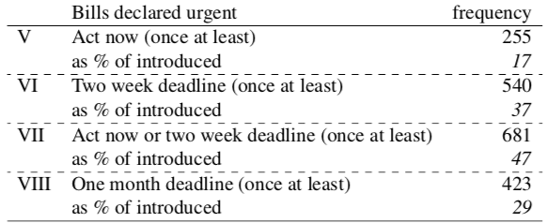
Types of Urgencies (Outcome Variable)
Notes:
A feature of importance for our argument is the distinction among types of urgency by degree. Although urgency authority is defined by the Constitution, Congress has distin- guished urgency types through its internal rules. The congressional organic law gives the president the choice to designate urgencies of ‘one month’ (urgencia simple or 30 days), ‘two weeks’ (urgencia suma or 15 days), or ‘act now’ (discusión inmediata or 6 days)
Bills can be urgent more than once. during Cámara consideration, one same bill often received many urgency designations—e.g., an initial one month deadline is reset before its expiration, or replaced by two weeks.
Siavelis (2002). Controlling for relevant features (such as the bill’s policy domain, the gov- ernment’s seat margin, or the presidential agenda size), urgency degrees had quite different effects on success rates. Higher degrees strongly and significantly associate with higher probability of executive success, while the lower made no statistical difference. Since low- degree urgencies were also quite prevalent, conflating them with the rest washed off the effect of the higher-degree in Siavelis’ analysis.
Degrees also matter because higher ones trigger restrictive floor consideration rules, whereas the lowest degree does not. For this reason, and unless otherwise noted, by “urgency” in this paper we mean ‘act now’ and ‘two week’ deadlines only, the types that are consequential for our argument (the closed rule is not applicable to ‘one month’ deadlines, see the appendix).
A systematic analysis of data in Table 2 is revealing. The units are individual executive proposals: the dependent variable Urgent bill equals 1 for proposals declared urgent while in the cámara, 0 otherwise. It excludes ‘one month’ deadlines, which do not trigger the closed rule, and urgencies declared when the bill was in the Senate.

Slide 17
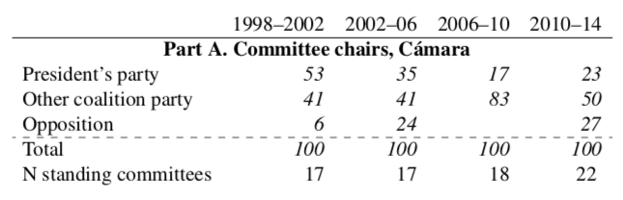
Main Independent Variable
Notes:
The first has two alternative specifications: Co-partisan comm. chair, equal 1 if the bill was referred to a standing committee presided by a member of the president’s party, 0 otherwise; or Coalition comm. chair, equal 1 for bills referred to committees chaired by members of any party in the presidential

Slide 18
Control variables
Multiple Referrals
Hacienda Referrals
Presidential Approval
Timing at bill introduction
Relax Deadlines
Fixed Effects by Legislature
Mixed Effects
Notes:
, for bill features, for timing, and for the strategic environment.
multiple referrals. Nearly one quarter (24 percent) of bills in the period were referred to more than one standing committee.
A single co-partisan or coalition chair among multiple referees suffices
It should capture any effect of agenda control sharing among several committee chairs in the proposal’s negotiation.
The bill features group consists of Hacienda referral, equal 1 for bills referred to the powerful Finance committee, 0 otherwise. The Hacienda committee has special status in the Chilean Congress. Unlike other standing committees, it has jurisdiction over every bill authorizing spending in any domain. Hacienda committee members, working in tandem with Finance Ministry staff, may or may not appropriate funds from the budget in their report to the floor (Alemán and Navia 2009). Not unlike the Appropriations and Rules committees in the U.S. House, Hacienda has the status of a control committee, a key asset for agenda power (Kiewiet and McCubbins 1991). Hacienda referral therefore controls for a subset of generally important proposals, and should associate positively with urgency authority.
The strategic environment group includes three controls. Pres. approval is the net pres- idential approval at bill initiation, Higher opinion rating are, other things constant, more successful in the legislative arena (Alemán and Navia 2009, Bond and Fleisher 1990),.
The timing group controls for the congressional cycle. Year remaining (and its squared value to capture non-linearity, if any) measures the percentage of legislative year remaining at bill initiation. Chilean legislative years begin after the (meridional) Summer break. So the variable adopts value 100 for proposals introduced on March 1 (the first day of the legislative year), and value 0 for proposals introduced the last day of February. It should control for stationarity in the data.
Given that observations from four elected Legislaturas, with important differences in
the types and the volume of proposals considered (Alemán and Navia 2009) are pooled,
heterogeneity might interfere. So we fit two additional model specifications for robustness
verification. One includes fixed Legislatura effects—i.e., three dummies for bills initiated
in the 2002–06, 2006–10, and 2010–14 periods, respectively; the excluded 1998–2002
Another adds further flexibility by also estimating separate errors for bills initiated in in each Legislatura (a so-called mixed effects model, Gelman and Hill 2007:262,302). Estimation is with a generalized linear model for the mixed effects fit, and logit for the rest.

Slide 19
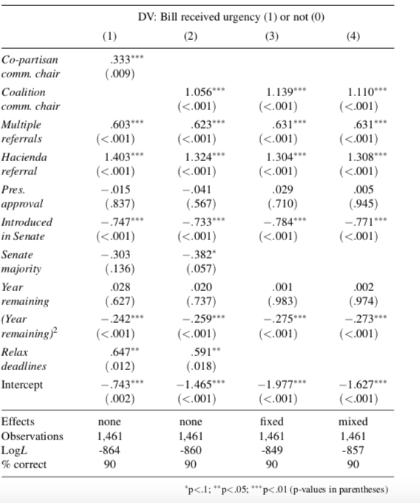
Notes:
Table 4 reports results.The regression model performs satisfactorily. Predictors across model specifications correctly classify 90 percent of the observations. Coefficient estimates confirm that, controlling other factors in the model, Co-partisan comm. chair has a positive coefficient in model 1, as expected. The evidence is much stronger for the variable’s other specification. The coefficient for Coalition comm. chair in models 2–4 is also positive, more than triples in size, and achieves p-values below .001. As scholars have documented, the coalition is as good a predictor of presidential support in Congress—or better, in our case—as the party. In general, all model coefficients remain pretty much unchanged in size and significance when fixed and mixed effects are included in the right side (we are forced to drop variables Senate majority and Relax deadlines due to co-linearity with Legislatura dummies).

Slide 20
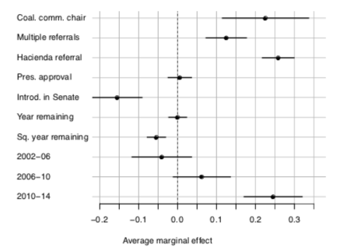
Average Marginal Effect
Notes:
changes in the average predicted probability of an urgent bill associated with unit changes in model 3’s explanatory variables (all other regressors at their mean value).
A report from a committee with a coalition chair experiences a .23 hike (and a .06 standard error) in the likelihood of getting a closed rule in the floor compared to a report by an opposition-chaired committee. The effect is nearly as big as the average marginal effects of Hacienda referral (.26), and double that of Multiple referrals (.12
The large effects of Hacienda and multiple referrals deserves comment. When spending gets in the way in Chile, restrictive rules are the norm. Recall that multiple referrals exclude the finance committee, so there is an independent effect of bills with jurisdictional overlaps worth investigating further. And the finance committee was always chaired by a coalition member but, with the exception of the 1998 to 2000 period, never by a co-partisan of the president. This may explain the milder effect of the partisan specification of our key variable in model 1.
Another control worth highlighting is Introd. in Senate. Bills successfully passing the upper chamber first, where the opposition was systematically larger and at times in con- trol were, other things constant, much less likely to get urgent status (the average marginal effect is −.16 and significant). Future research should pay attention to inter-cameral ne- gotiation, in general, and the reliance on urgency in the upper chamber, in particular. In any event, our results indicate that agreements and compromises reached to in the Senate required less, not more, protection from floor amendments in the Cámara’s plenary.

Slide 21
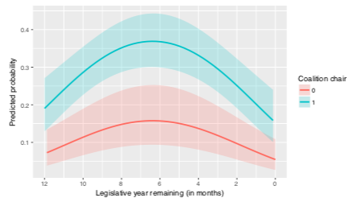
Predicted Probabilities
Notes:
. The president’s approval (insignificant across models) is set to the median value in the period. The inverted-U shape shows how urgency probability, predicted at .2 for coalition-chaired committees at the start, and .075 for the rest, becomes much likelier in the first half of the legislative year. By the second quarter (June–August), the probability is at its maximum, about .37 percent and .16, respectively. It then experiences a sharp drop, ending the austral Summer break at .16 for coalition-chaired committees, and .05 for others. And the gap be- tween the 95-percent confidence bands of the predictions is quite plain, giving confidence

Slide 22
Wrap-Up
Urgency authority = closed rule
Unlike Rules Committee, Chilean prez controls this
Evidence that president–chair preference similarity → increase urgencies
More tests:
Use nominate scores instead of partisan dummies
Study amendments, admitted v. not: Corr(amendments, urgency) < 0?
Thank you!

Slide 23
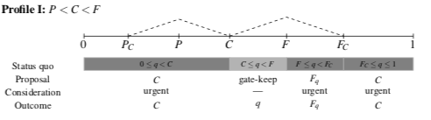
Results

Slide 24
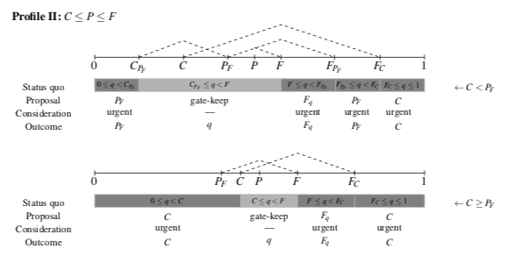
Results

Slide 25
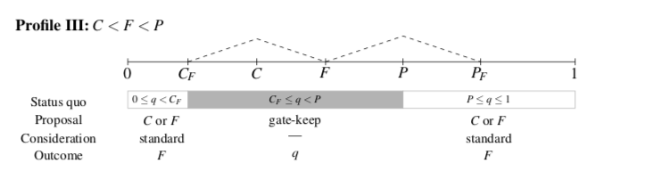
Results

